Slide 1
Digital Image Processing
About the class
Notes:
Today we begin Digital Image Processing, a foundational course that bridges computer science, mathematics, and real-world systems such as medical imaging, satellite vision, and autonomous systems.
This course is not about image editing alone; it is about understanding how machines acquire, represent, enhance, analyse, and reason about visual data.

Slide 2
Tentative Syllabus
Prerequisites
Objectives
Textbook
Grade
Notes:
This course is designed as a computer science course with strong mathematical grounding.
You will learn not only what image processing algorithms do, but why they work and how to design them.
We will move from low-level pixel operations to higher-level interpretation and analysis.

Slide 3
About Instructor
Dr. Behnam Kiani Kalejahi
PhD in Biomedical Engineering
Area of Research Interest
  Biomedical Image Processing
  Cyber Security
Contact:
  B.kiani@centralasian.uz
Consultation hours(Tentative): Monday-Thursday 15:00 to 17:00
Office: Room # A - 257
Notes:
The course is taught by Dr. Behnam Kiani Kalejahi, whose background spans biomedical engineering and computer engineering.
His research interests in biomedical image processing directly influence this course, especially in medical imaging examples such as MRI, CT, and ultrasound.
Consultation hours are available for both conceptual and technical questions.

Slide 4
Prerequisites of This Course
This is a computer science course
It will involve a fair amount of math
– calculus, linear algebra, geometry
– probability
– analog/digital signal processing
– graph theory etc.
It will involve the modeling and design of a real system
– Programming skills with matlab, Python, or C++
Notes:
This course assumes comfort with:
Calculus and linear algebra
Probability and signals
Programming in MATLAB, Python, or C++
Image processing is inherently mathematical. Pixels are numbers, images are matrices, and algorithms are transformations. If you understand matrices, you understand images.

Slide 5
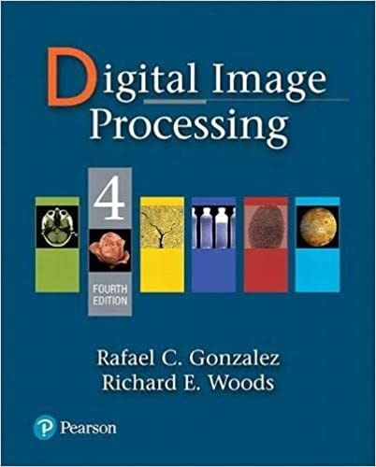
Textbook
Required:
Digital Image Processing, Rafael C. Gonzalez and Richard E. Woods, 4th Edition, Pearson
We will cover many topics in this text
book
We will also include special topics on recent progresses on image processing
Notes:
The primary reference is Gonzalez & Woods – Digital Image Processing, one of the most cited texts in the field.
We will not follow it mechanically; instead, we will extract key principles and combine them with recent advances and real-world applications.

Slide 6
Grading policy
Internship | 10%
Mid-term, written exam. | 20%
Final, written exam | 50%
Continuous assessment | 10%

Slide 7
Mid term
Mid-term will be taken totally on paper.
Mid may include
  Understanding of the concepts.
  Exercises
  Basic python codes to solve the problems.
Notes:
The midterm is paper-based, focusing on conceptual understanding.
You may be asked to:
Explain algorithms
Solve small mathematical problems
Write short Python-style pseudocode
This evaluates whether you understand the logic behind the methods.

Slide 8
Final
You may be provided with a problem that will require some algorithm to use.
You maybe provided the before and after effects of an algorithm and will be asked the type of algorithm used in the process.
Some exercises.
Python source codes for some simple unseen algorithms
Notes:
The final exam emphasizes problem-solving and interpretation.
You may be shown before-and-after images and asked:
What algorithm was used?
Why was it appropriate?
What are its limitations?
This reflects how image processing is used in practice.

Slide 9
Major Topics Covered in Class
Image acquisition and digital image representation
Image enhancement
Image restoration
Color image processing Image
Compression Image
Segmentation
Morphological image processing
Special topics on recent progresses on digital image processing
Notes:
We will cover the full pipeline:
Image acquisition
Enhancement and restoration
Compression
Segmentation
Morphology
Advanced and recent topics
Each topic builds on the previous one—this is a system, not isolated tools.

Slide 10
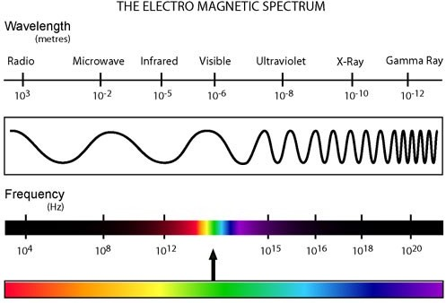
Human Perception VS Machine Vision
Limited vs entire EM spectrum
http://www.kollewin.com/blog/electromagnetic-spectrum/
Notes:
This slide highlights a fundamental limitation of human vision compared to machine vision.
Humans perceive only a very narrow band of the electromagnetic spectrum—what we call visible light, roughly between 400 and 700 nanometres.
Everything outside this narrow range—infrared, ultraviolet, X-rays, gamma rays—exists in the same physical world, but is completely invisible to us without technological assistance.
Machines, however, are not biologically constrained. Cameras and sensors can be designed to operate across almost the entire electromagnetic spectrum, from radio waves to gamma rays.
This is why we can perform MRI scans, CT imaging, infrared surveillance, satellite imaging, and ultrasound diagnostics—all of which rely on information humans cannot directly perceive.
In digital image processing, this distinction is critical.
An “image” is not defined by visibility to humans—it is defined by measurable energy captured by a sensor and converted into data.
Once captured and digitised, an infrared image, an X-ray image, and a visible-light photograph are all treated similarly:
they become matrices of numbers that can be processed using the same mathematical tools.
This is one of the key reasons machine vision often outperforms human vision in medical diagnostics, security, and industrial inspection:
machines can see more, measure more, and operate objectively across spectra humans cannot access.
Throughout this course, we will repeatedly return to this idea:
image processing is not about making images look nice—it is about extracting information from data beyond human perception.

Slide 11
Image Processing → Image Analysis
Image acquisition
Image enhancement Image compression Image segmentation Object recognition
Low level
Image processing
Mid level
Image analysis (Computer vision, Pattern recognition, etc.)
Scene understanding
Semantics
High level
Notes:
This slide summarises the entire conceptual hierarchy of this course, moving from raw data handling to high-level interpretation.
At the low level, we are concerned with the image itself.
This includes image acquisition, enhancement, and compression.
The goal here is to improve image quality or efficiency, without attempting to understand what the image contains.
These operations fall under image processing.
They work directly on pixel values and are generally task-independent.
At the mid level, we begin to introduce meaning.
Image segmentation divides an image into regions, and object recognition assigns labels to those regions.
This is where the transition from processing to analysis begins.
At the high level, we deal with scene understanding and semantics.
Here, the system answers questions such as:
What is happening in the image?
What objects are present, and how do they relate to each other?
These higher levels fall under image analysis, also known as computer vision and pattern recognition.
The focus shifts from pixels to information, structure, and interpretation.
The arrow on the left emphasises that this is a progressive abstraction.
As we move upward, we rely increasingly on models, learning, and prior knowledge, and less on raw pixel manipulation.
A key takeaway is that errors at lower levels propagate upward.
Poor acquisition or enhancement will negatively impact segmentation, recognition, and semantic understanding.
Throughout this course, we will mostly operate at the low and mid levels, while providing a conceptual bridge to modern high-level vision systems.

Slide 12
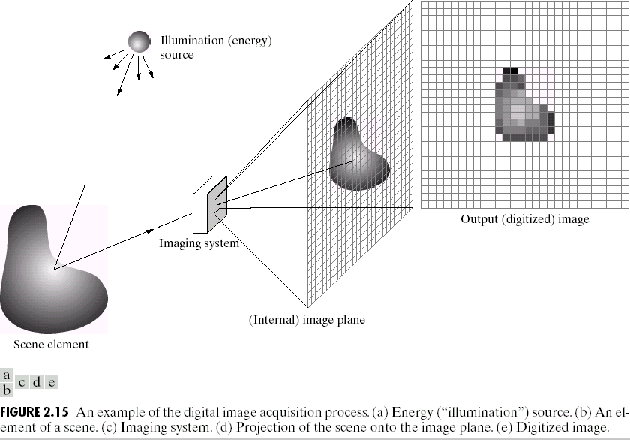
Image Acquisition and Representation
Notes:
This figure illustrates the complete digital image acquisition pipeline, from the physical world to a digital image stored in a computer.
Understanding this pipeline is essential, because many image quality problems originate at this stage, not during processing.
We begin with an illumination or energy source.
This could be visible light, X-rays, infrared radiation, ultrasound waves, or any other form of electromagnetic or acoustic energy, depending on the imaging modality.
That energy interacts with a scene element, which is the object or tissue we want to image.
Different materials absorb, reflect, transmit, or scatter energy differently.
This interaction encodes information about the scene into the energy signal.
The modified energy then enters the imaging system.
This system may include lenses, mirrors, sensors, and electronic components.
Its job is to project the scene onto an internal image plane while preserving spatial information.
On the image plane, we still have a continuous representation of the scene.
At this point, the image is not digital yet.
It exists as a continuous distribution of energy or intensity.
The final step is digitisation, which involves two operations:
Sampling: dividing the image plane into a grid of pixels
Quantisation: assigning each pixel a discrete intensity value
The result is the output digital image, represented as a matrix of numbers.
This is the form that computers can store, process, analyse, and transmit.
A key takeaway here is that image processing starts only after acquisition.
If illumination is poor, sampling is insufficient, or noise is introduced at this stage, no algorithm can fully recover the lost information.
Throughout this course, we will frequently refer back to this model, because enhancement, restoration, segmentation, and recognition are all constrained by how the image was acquired.

Slide 13
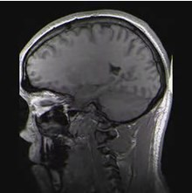
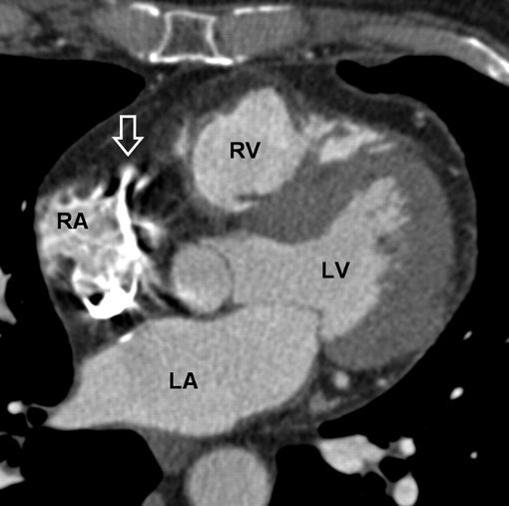

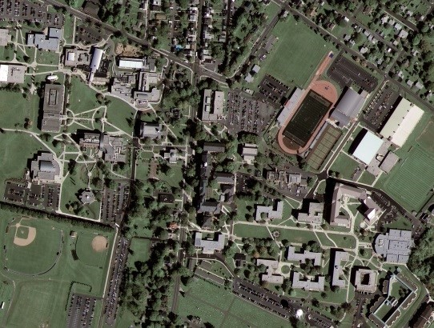
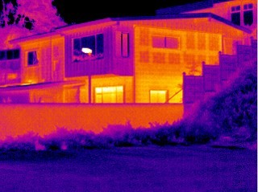
Examples
1. Brain MRI
2. Cardiac CT
3. Fetus Ultrasound
5. IR image
1 and 3. http://en.wikipedia.org
2. http://radiology.rsna.org
4. Satellite image
http://emap-int.com
http://www.imaging1.com
Notes:
The first example is a Brain MRI.
MRI uses radiofrequency signals and magnetic fields, not visible light.
The resulting image encodes tissue properties such as proton density and relaxation times.
The second example is a Cardiac CT scan.
CT images are generated using X-ray attenuation and provide high-resolution structural information, particularly useful for bones and cardiac anatomy.
The third image is a Fetal Ultrasound.
Here, the image is formed using acoustic waves, not electromagnetic radiation.
Despite the different physics, the final output is still a 2D grid of intensity values.
The fourth image is a Satellite image, captured from space using optical or multispectral sensors.
These images are commonly used in environmental monitoring, urban planning, and defence applications.
The fifth example is an Infrared (IR) image, which represents temperature variations rather than visible colour.
Such images are widely used in surveillance, building inspection, and medical thermography.
The key message of this slide is that image processing techniques do not depend on how the image was created.
Once the data is digitised, enhancement, segmentation, compression, and analysis can be applied using the same mathematical framework.
Throughout this course, we will repeatedly work with images from different domains to emphasise that the power of digital image processing lies in its generality.

Slide 14
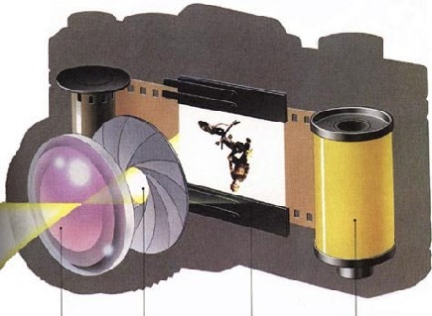
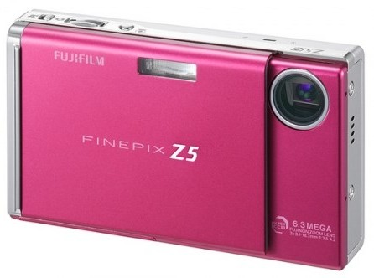
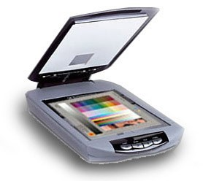
Image Acquisition
Camera + Scanner → Digital Camera: Get images into computer
lens aperture shutter
film
Notes:
This slide focuses on how images are physically captured and transferred into a computer.
At its core, image acquisition converts real-world energy into digital data.
Traditionally, this involved two separate steps:
a camera, which captures the image, and a scanner, which digitises it.
Modern digital cameras combine both functions into a single device.
Let’s briefly review the key components shown here:
The lens focuses incoming light onto the sensor or film
The aperture controls how much light enters the system
The shutter controls how long the light is allowed to enter
In film cameras, the image was recorded on film, which then required scanning to become digital.
In digital cameras, the film is replaced by an electronic sensor, which directly converts light into electrical signals.
Those signals are immediately sampled and quantised, producing a digital image that can be stored, displayed, or processed by a computer.
The important point for this course is that image quality is strongly influenced at this stage.
Incorrect exposure, motion blur, or poor sensor resolution cannot be fully corrected later using image processing algorithms.
Therefore, image acquisition is not just a hardware issue—it defines the upper limit of performance for all subsequent image processing and analysis tasks.

Slide 15

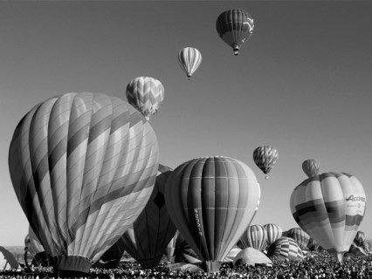
Image Representation
Discrete representation of images
we’ll carve up image into a rectangular grid of pixels P[x,y]
each pixel p will store an intensity value in [0 1]
0 → black; 1 → white; in-between → gray
Image size mxn → (mn) pixels
Notes:
In the real world, images are continuous.
In a computer, images must be discrete.
To achieve this, we divide the image into a rectangular grid of pixels, denoted mathematically as $P\left(x , y\right)$.
Each pixel stores a single numerical intensity value.
In a grayscale image, this value is typically normalised between 0 and 1:
0 represents black
1 represents white
values in between represent different shades of grey
When we talk about image size $m×n$, we are referring to m rows and n columns of pixels, resulting in a total of $m×n$numbers stored in memory.
The zoomed-in image on this slide illustrates an important consequence of discretisation:
when we enlarge a digital image, we eventually see individual square pixels rather than smooth edges.
This pixel grid is not a limitation of display—it is a fundamental property of digital images.
All image processing operations—filtering, enhancement, segmentation—operate on these pixel values.
From a mathematical perspective, an image is simply a matrix of numbers.
Once we accept this, techniques from linear algebra, statistics, and optimisation naturally apply.
Later in the course, we will see how changing pixel values locally or globally allows us to enhance contrast, remove noise, detect edges, and recognise objects.

Slide 16
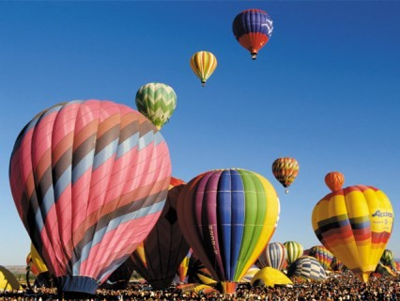



Color Image
Red
(1,0,0)
Green
(0,1,0)
Blue
(0,0,1)
0.6
0.0
0.8
+
0
Colors along Red axis
1
RGB
channels
Notes:
Up to now, we have discussed grayscale images, where each pixel stores a single intensity value.
A colour image extends this idea by storing multiple intensity values per pixel.
The most common colour representation is RGB, which stands for Red, Green, and Blue.
Each pixel is represented by a three-element vector:
$$\left(R , G , B\right)$$
where each component typically lies between 0 and 1.
The pure colours shown at the top illustrate the basis vectors of RGB space:
Red = (1, 0, 0)
Green = (0, 1, 0)
Blue = (0, 0, 1)
Any colour can be formed by linearly combining these three components.
For example, the diagram on the right shows a colour generated by combining:
0.6 of red
0.0 of green
0.8 of blue
which produces a purple colour.
From a computational perspective, this is extremely important:
a colour image is simply three grayscale images stacked together—one for each channel.
The images at the bottom demonstrate this separation.
The original image is decomposed into its red, green, and blue channels, each of which can be processed independently or jointly.
This representation allows us to:
Enhance or suppress specific colours
Perform colour-based segmentation
Convert between colour spaces such as RGB, HSV, and YCbCr
Throughout this course, we will often treat colour images as three-dimensional data structures, with dimensions $m×n×3$.

Slide 17
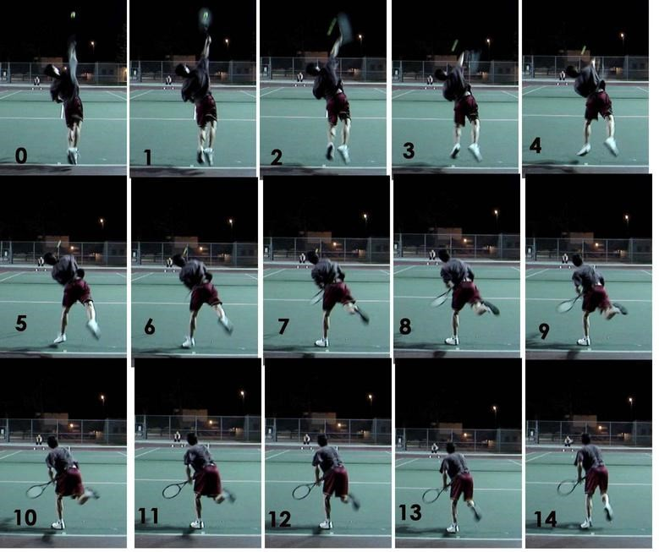
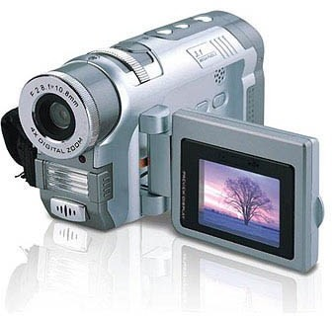
Video: Frame by Frame
30 frames/second
Notes:
In most standard video systems, video is recorded at 30 frames per second.
This means that every second of video consists of 30 individual still images, or frames.
Each frame is a complete digital image, with the same structure we discussed earlier:
a grid of pixels, possibly with multiple colour channels.
What creates the perception of motion is not anything special in the images themselves, but the temporal sampling rate.
When frames are displayed quickly enough, the human visual system perceives continuous motion rather than discrete images.
From an image processing perspective, this is powerful because it means that many image algorithms can be applied frame by frame.
For example, enhancement, noise reduction, and edge detection can be performed independently on each frame.
However, video also introduces a time dimension.
This allows us to analyse motion, track objects, estimate velocity, and detect events—tasks that are not possible with a single image.
Mathematically, we can think of a video as a three-dimensional signal:
$$I\left(x , y , t\right)$$
where $x$and $y$represent spatial coordinates, and $t$represents time.
Later in the course, we will see how temporal information is exploited in applications such as video compression, surveillance, and action recognition.

Slide 18
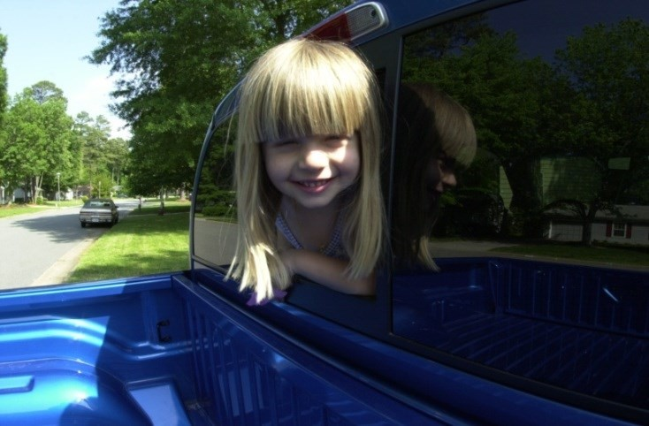
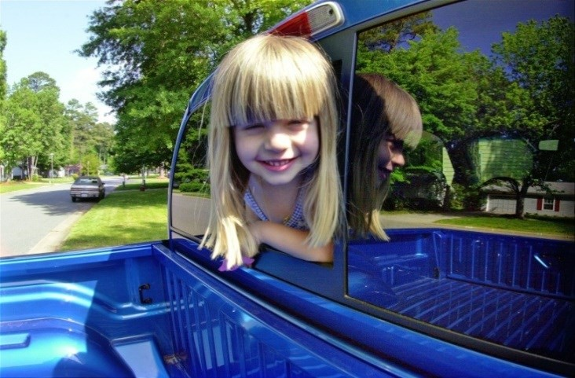
Image Enhancement
Notes:
Image enhancement refers to techniques that improve the visual appearance of an image or make it more suitable for a specific task.
The key point is that enhancement is subjective—what looks “better” depends on the observer or application.
In the example shown here, the image on the right appears clearer and more visually pleasing than the original on the left.
This improvement may be due to adjustments in brightness, contrast, colour balance, or sharpness.
Image enhancement does not attempt to recover the true original scene.
Instead, it emphasises certain features while possibly suppressing others, often to aid human interpretation or subsequent processing.
Common enhancement techniques include:
Contrast stretching and histogram equalisation
Smoothing and sharpening filters
Colour enhancement and gamma correction
It is important to distinguish enhancement from image restoration.
Enhancement is heuristic and visually driven, whereas restoration is model-based and aims to reverse known degradations such as blur or noise.
In many practical applications—such as medical imaging, surveillance, and photography—enhancement is used as a pre-processing step to improve visibility before segmentation or analysis.
Throughout this course, we will study enhancement techniques in both the spatial domain and the frequency domain, and evaluate how they affect image quality and interpretability.

Slide 19


Image Restoration
Notes:
Image restoration addresses a fundamentally different problem from image enhancement.
While enhancement aims to improve visual appearance, restoration aims to recover the original, undistorted image as accurately as possible.
The example shown here illustrates a degraded image on the left and a restored version on the right.
The degradation may be due to blur, noise, motion, sensor limitations, or aging of the medium, as is often the case with historical artwork or scanned images.
The key characteristic of image restoration is that it is model-based.
We assume that the observed image is the result of an original image that has been corrupted by a known or estimated degradation process.
Mathematically, this is often expressed as:
$$g\left(x , y\right)=h\left(x , y\right)∗f\left(x , y\right)+n\left(x , y\right)$$
where:
$f\left(x , y\right)$is the original image
$h\left(x , y\right)$is the degradation function
$n\left(x , y\right)$is noise
$g\left(x , y\right)$is the observed image
Restoration techniques attempt to invert or compensate for this degradation, using methods such as inverse filtering, Wiener filtering, or regularised optimisation.
Unlike enhancement, restoration has an objective criterion:
how close the restored image is to the true original, even if the result does not necessarily look “prettier”.
In applications such as medical imaging, astronomy, and remote sensing, restoration is critical because diagnostic accuracy depends on faithful signal recovery, not visual appeal.

Slide 20
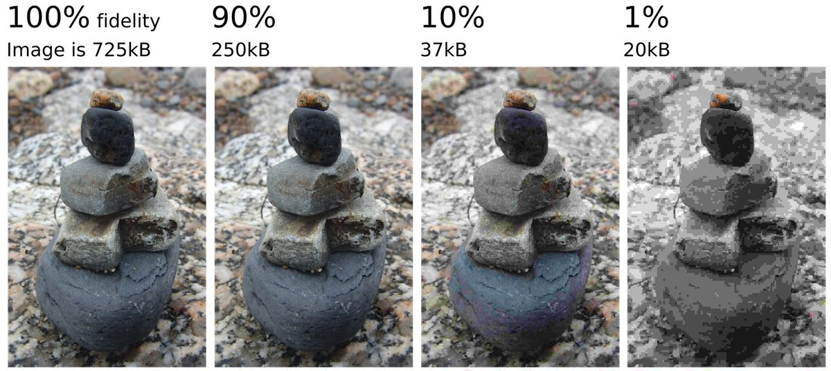
Image Compression
→ Video compression
Notes:
Image compression addresses the problem of reducing the amount of data required to represent an image, while preserving as much useful information as possible.
The examples on this slide show the same image stored at different fidelity levels.
At 100% fidelity, the image is large but visually accurate.
As compression increases—from 90% down to 1%—file size decreases dramatically, but visual quality degrades.
This illustrates the central trade-off in compression:
storage and transmission efficiency versus image quality.
Compression works by exploiting redundancy in images:
Spatial redundancy: neighbouring pixels are often similar
Spectral redundancy: colour channels are correlated
Perceptual redundancy: the human visual system is less sensitive to certain distortions
There are two broad classes of compression:
Lossless compression, where the original image can be perfectly reconstructed
Lossy compression, where some information is discarded in exchange for higher compression ratios
Most widely used image formats, such as JPEG, rely on lossy compression, because they achieve substantial size reduction with acceptable visual loss.
The final point on the slide highlights that video compression extends these ideas further.
In addition to spatial redundancy within a frame, video compression exploits temporal redundancy between frames, enabling even greater data reduction.
Image and video compression are essential for applications such as medical imaging archives, streaming media, mobile devices, and real-time communication.

Slide 21
Image Processing → Image Analysis
Image acquisition
Image enhancement Image compression Image segmentation Object recognition
Low level
Image processing
Mid level
Image analysis (Computer vision, Pattern recognition, etc.)
Scene understanding
Semantics
High level
Notes:
This slide clarifies the conceptual boundary between image processing and image analysis, which is central to understanding the scope of this course.
At the low level, we deal exclusively with image processing tasks:
Image acquisition
Image enhancement
Image compression
These operations work directly on pixel intensities.
They are generally independent of image content and do not attempt to assign meaning.
As we move to the mid level, we begin the transition toward image analysis.
Image segmentation separates the image into regions, and object recognition assigns labels to those regions.
At the high level, we fully enter the domain of image analysis, which includes:
Scene understanding
Semantics
At this stage, the system is no longer manipulating pixels—it is reasoning about objects, relationships, and context.
The bracket on the right emphasises that image analysis overlaps with computer vision and pattern recognition.
These fields focus on interpretation rather than appearance.
The downward arrow on the left represents increasing semantic complexity as we move from raw data to understanding.
A critical point is that image processing is a prerequisite for image analysis.
Reliable segmentation, recognition, and semantic interpretation depend on high-quality acquisition and preprocessing.
In modern systems, especially those based on deep learning, these stages may be integrated—but conceptually, this hierarchy still applies.

Slide 22
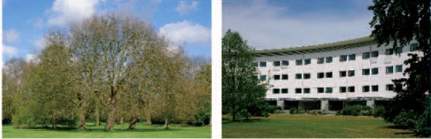
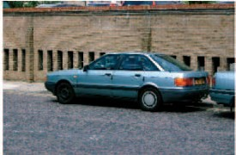
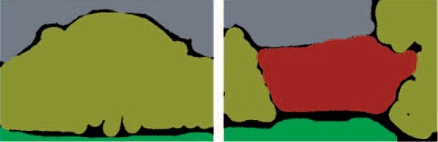
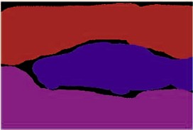
Image Segmentation
Microsoft multiclass segmentation data set
Notes:
Image segmentation is the process of partitioning an image into meaningful regions.
Each region corresponds to a distinct object, surface, or area of interest.
In the examples shown here, the top row contains the original images, and the bottom row shows their segmented versions.
Notice that each region is assigned a different colour to indicate class membership.
The goal of segmentation is not to improve visual quality, but to simplify the image representation so that higher-level analysis becomes possible.
Conceptually, segmentation answers the question:
Which pixels belong together?
Segmentation is a critical bridge between image processing and image analysis.
Without accurate segmentation, tasks such as object recognition, measurement, and scene understanding become unreliable.
Depending on the application, segmentation can be:
Binary: foreground vs background
Multiclass: multiple object categories, as shown here
Instance-based: separating individual objects of the same class
The dataset referenced on this slide—the Microsoft multiclass segmentation dataset—is commonly used to evaluate segmentation algorithms under real-world conditions.
Segmentation is also one of the most challenging problems in image processing.
It is highly sensitive to noise, illumination changes, and object boundaries, which is why preprocessing steps such as enhancement and smoothing are often required.
In later parts of the course, we will study classical segmentation techniques, and conceptually connect them to modern learning-based approaches.

Slide 23
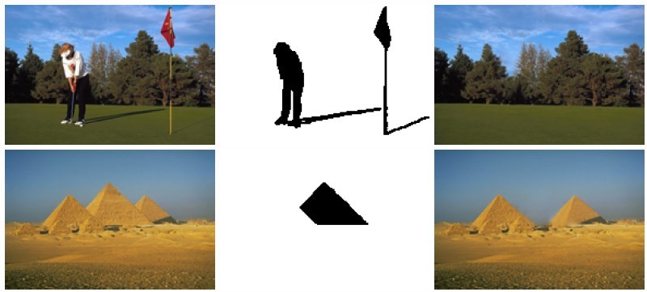
Image Completion
Interactively select objects. Remove them and automatically fill with similar background (from the same image)
I. Drori, D. Cohen-Or, H. Yeshurun, SIGGRPAH’03
Notes:
Image completion, sometimes called image inpainting, is the process of removing selected objects or regions from an image and automatically filling the missing areas using information from the surrounding background.
In the examples shown here, the object of interest is first identified or selected, either manually or automatically.
The selected region is then removed, leaving a mask that indicates where information is missing.
The algorithm’s task is to fill this region in a way that is visually consistent with the rest of the image.
This includes matching texture, colour, and structural patterns from nearby regions.
A key constraint in image completion is that all information used to fill the missing area comes from the same image.
No external data is introduced; the method relies entirely on internal image statistics.
Conceptually, image completion assumes that natural images contain redundancy.
If a texture or structure appears in one part of the image, it is likely to appear elsewhere as well.
Image completion is used in many applications, including:
Object removal in photography
Restoration of damaged images or artwork
Occlusion handling in computer vision
From a course perspective, image completion sits at the intersection of image processing and image analysis.
It requires low-level operations such as texture synthesis, but also higher-level understanding of scene structure.
While early methods relied on patch-based techniques, modern approaches increasingly use learning-based models, which we will conceptually discuss later in the course.

Slide 24
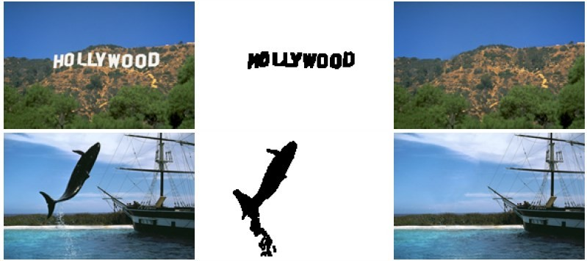
More Examples
Notes:
This slide presents additional examples of image completion and object removal, reinforcing the concepts introduced in the previous slide.
In each case, the object of interest—such as the Hollywood sign or the diver—is first identified and removed, leaving a missing region defined by a mask.
The image completion algorithm then fills the missing region using contextual information from the surrounding areas.
Notice that the completed images appear visually plausible, even though the removed objects are large and semantically important.
This highlights an important characteristic of image completion:
the algorithm does not understand the meaning of the removed object—it relies on local and global image statistics.
In the top example, the sky and hillside textures are extended naturally into the removed region.
In the bottom example, water and background structures are propagated to maintain visual continuity.
These examples also demonstrate the limitations of image completion.
While backgrounds and textures are reconstructed well, complex structures or unique objects cannot always be restored accurately.
From a methodological perspective, this task lies between low-level texture synthesis and higher-level scene understanding, making it an interesting and challenging area in image processing.
Modern approaches increasingly incorporate learning-based models, but the core principle remains the same:
fill missing regions in a way that is statistically and visually consistent with the rest of the image.

Slide 25

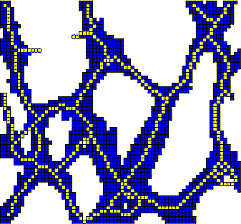
Morphological Image Processing
Notes:
Morphological image processing is a class of techniques that focus on the shape and structure of objects in an image, rather than on intensity values alone.
These methods are particularly powerful for binary and grayscale images, where the goal is to analyse or modify geometric structures such as boundaries, connectivity, and thickness.
The examples on this slide illustrate typical morphological operations.
On the left, we see how shapes—such as handwritten characters—can be refined, cleaned, or simplified.
On the right, we see how morphology can extract or emphasise structural patterns, such as connected components or skeletons.
At the core of morphological processing is the concept of a structuring element.
This is a small predefined shape that probes the image and defines how objects are expanded, shrunk, or transformed.
The two fundamental morphological operations are:
Erosion, which removes pixels from object boundaries and shrinks objects
Dilation, which adds pixels to object boundaries and expands objects
From these, more advanced operations are constructed, such as:
Opening, which removes small objects or noise
Closing, which fills small gaps or holes
Morphological operations are widely used as pre-processing steps before segmentation or recognition, particularly when dealing with noisy or fragmented objects.
Importantly, morphology is non-linear.
Unlike filtering, it does not rely on averaging or convolution, but on set-theoretic and geometric principles.
In applications such as character recognition, medical image analysis, and network structure extraction, morphology provides a robust way to enforce shape-based constraints.

Slide 26
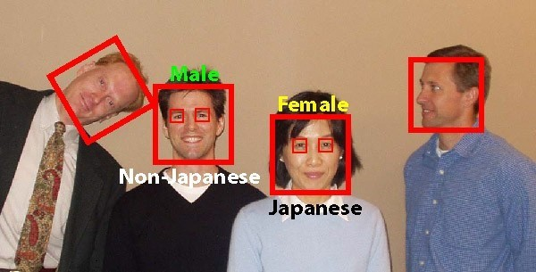
Object Detection / Recognition
Notes:
This slide introduces object detection and object recognition, two closely related but conceptually distinct tasks in image analysis.
Object detection answers the question:
Where is an object in the image?
It typically involves locating objects and drawing bounding boxes around them, as shown by the red rectangles in this example.
Object recognition, on the other hand, answers the question:
What is the object?
Once an object is detected, recognition assigns a label or category to it, such as a face, a person, or another class of interest.
In practice, these two tasks are often performed together.
A system first detects candidate regions, and then recognises or classifies the content of those regions.
The example shown here illustrates a face detection and recognition pipeline.
Faces are detected using bounding boxes, and then additional attributes—such as category labels—are inferred based on learned patterns.
From a methodological perspective, object detection and recognition operate at the mid to high levels of the image processing hierarchy.
They rely on earlier stages such as image acquisition, enhancement, and segmentation to function reliably.
These tasks are central to many applications, including:
Surveillance and security
Human–computer interaction
Medical image analysis
Autonomous systems
Historically, object recognition relied on hand-crafted features such as edges, corners, and texture descriptors.
Modern systems increasingly use learning-based models that automatically learn features from data, but the underlying goals remain the same.
A key challenge in object detection and recognition is variability—objects may appear at different scales, orientations, and under different lighting conditions.

Slide 27
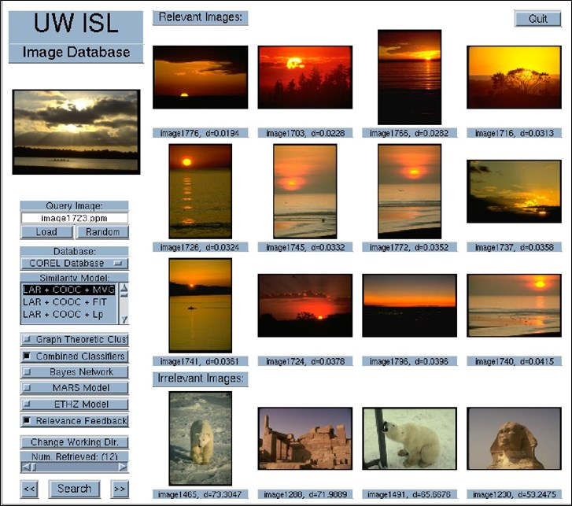
Content-Based Image Retrieval
Notes:
Content-Based Image Retrieval, or CBIR, refers to the task of searching an image database using the visual content of images themselves, rather than relying on text labels, filenames, or manual annotations.
In this slide, you can see a typical CBIR system interface.
A query image is provided by the user, and the system retrieves images from a database that are visually similar to the query.
The key idea behind CBIR is that images are represented using visual features, such as:
Colour distributions
Texture patterns
Shape descriptors
Local features or learned representations
These features are extracted from every image in the database and stored in a feature space.
When a query image is submitted, its features are compared to those in the database using a similarity measure.
Images that are closest in feature space are returned as relevant images, while others are classified as irrelevant, as shown on the slide.
CBIR operates at the high level of image analysis, because it attempts to answer the question:
Which images are visually or semantically similar to this one?
This task is challenging because visual similarity does not always match human perception or semantic meaning.
Two images may look similar in colour or texture but represent very different concepts.
CBIR systems are used in many applications, including:
Medical image databases
Digital libraries and archives
Surveillance and forensics
E-commerce and multimedia search
Modern CBIR systems increasingly rely on learning-based representations, but the core principle remains the same:
retrieve images based on content, not text.

Slide 28
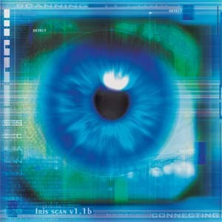
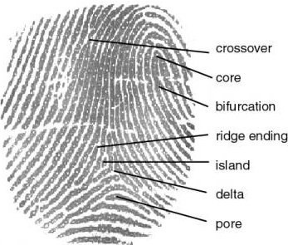
Biometrics
Notes:
Biometrics refers to the automatic identification or verification of individuals based on their biological or behavioural characteristics.
In image processing, this typically involves analysing visual patterns that are unique to each person.
The two examples shown here are iris recognition on the left and fingerprint analysis on the right.
Both rely on the fact that certain anatomical patterns are highly distinctive and stable over time.
In iris recognition, the system analyses complex texture patterns in the coloured region surrounding the pupil.
These patterns are captured using specialised imaging and encoded into a compact digital representation.
In fingerprint recognition, the focus is on structural features, such as ridge endings, bifurcations, and core points.
These features, often called minutiae, form the basis for matching fingerprints across databases.
From an image processing perspective, biometric systems involve multiple stages:
Image acquisition under controlled conditions
Enhancement to improve contrast and clarity
Feature extraction to identify distinctive patterns
Matching or classification for identification or verification
Biometrics operates at the high level of image analysis, because the goal is not just to process images, but to establish identity.
These systems are widely used in applications such as:
Access control and authentication
Border security and passports
Forensic identification
Mobile device security
A key challenge in biometric systems is variability.
Images may differ due to lighting, pose, noise, or partial occlusion, yet the system must remain reliable.
This makes biometrics a strong example of how image processing, pattern recognition, and decision-making come together in a real-world system.

Slide 29
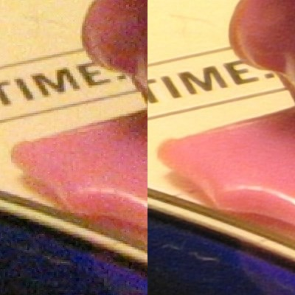
Super-Resolution
Notes:
Super-resolution refers to a class of techniques that aim to increase the spatial resolution of an image, producing a higher-resolution version from one or more low-resolution observations.
The example shown here compares a low-resolution image on the left with a super-resolved image on the right.
Notice that the goal is not just to enlarge the image, but to recover finer details that were not clearly visible before.
It is important to distinguish super-resolution from simple interpolation, such as nearest-neighbour or bicubic resizing.
Interpolation only estimates new pixel values based on existing ones, often resulting in smooth but blurry images.
Super-resolution, in contrast, attempts to reconstruct high-frequency details, such as edges and textures.
Super-resolution can be approached in two main ways:
Single-image super-resolution, where a single low-resolution image is enhanced
Multi-image super-resolution, where multiple low-resolution images of the same scene are combined
Conceptually, super-resolution relies on prior knowledge about natural images.
This prior may come from statistical models, example patches, or learned representations.
From the image processing hierarchy, super-resolution lies between restoration and analysis.
It is more ambitious than denoising or deblurring, because it attempts to infer information that is not explicitly present in the input image.
Super-resolution has important applications in:
Medical imaging, where acquisition resolution is limited
Surveillance and remote sensing
Consumer photography and video enhancement
A key limitation to remember is that super-resolution is ultimately an ill-posed problem.
The reconstructed details are plausible estimates, not guaranteed ground truth.

Slide 30
Applications of Digital Image Processing
Digital camera
Photoshop
Human computer interaction
Medical imaging for diagnosis and treatment Surveillance
Automatic driving
…
Fast-growing market!
Notes:
This slide highlights the breadth and impact of digital image processing across modern technology and society.
In digital cameras, image processing is used continuously—often in real time—to perform noise reduction, colour correction, compression, and enhancement before an image is even saved.
Tools such as Photoshop represent the creative and professional side of image processing, where enhancement, restoration, and manipulation techniques are applied for visual communication and media production.
In human–computer interaction, image processing enables gesture recognition, face tracking, eye tracking, and augmented reality, allowing systems to respond naturally to human behaviour.
One of the most critical application areas is medical imaging for diagnosis and treatment.
Here, image processing supports clinicians by improving image quality, enabling segmentation of organs or lesions, and assisting with quantitative analysis.
Surveillance systems rely heavily on image analysis for detection, tracking, and recognition, often operating under challenging conditions such as low light or crowded scenes.
In automatic driving, image processing and computer vision are essential for lane detection, obstacle recognition, traffic sign interpretation, and scene understanding.
The ellipsis on this slide emphasises that this list is far from complete.
Image processing underpins fields such as robotics, remote sensing, manufacturing, and scientific research.
The final point—fast-growing market—is important.
Advances in sensors, computing power, and algorithms have made image processing one of the most rapidly expanding areas in engineering and applied science.
This course provides the foundational principles that support all of these applications, regardless of how technologies evolve.

